Slide 1
Azure Solution Alignment Workshop
Module 8a – Monitoring

Slide 2
High-level agenda
Azure Monitoring overview and offerings
Azure Monitor (built-in monitoring)
Azure Network Watcher
Azure Advisor
Azure Security Center
OMS overview
Log Analytics (part of OMS)
Application Insights
SCOM
Key decisions

Slide 3
Azure Monitoring overview

Slide 4
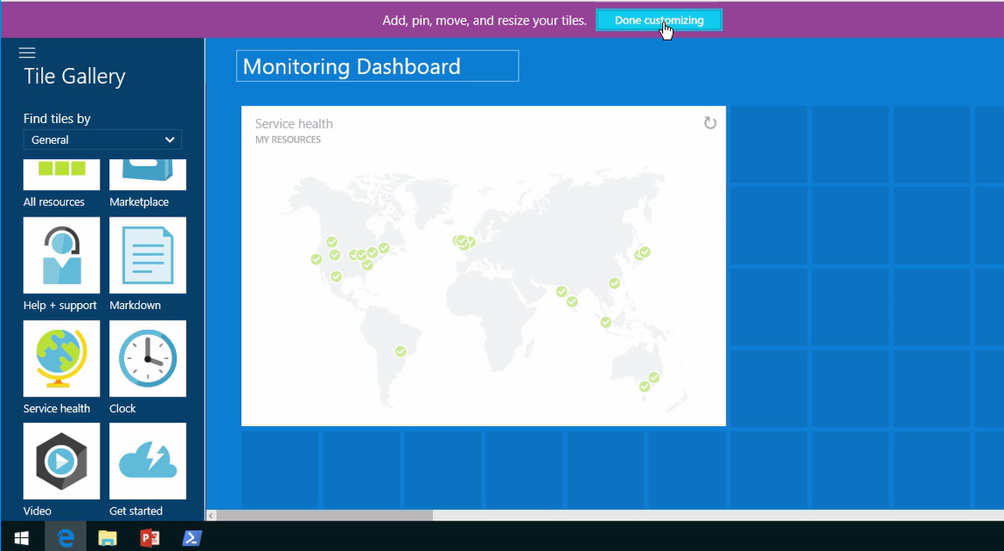
Azure Service Health
Azure Services
State of Azure Services
Data sourced from https://azure.microsoft.com/en-us/status/.

Slide 5
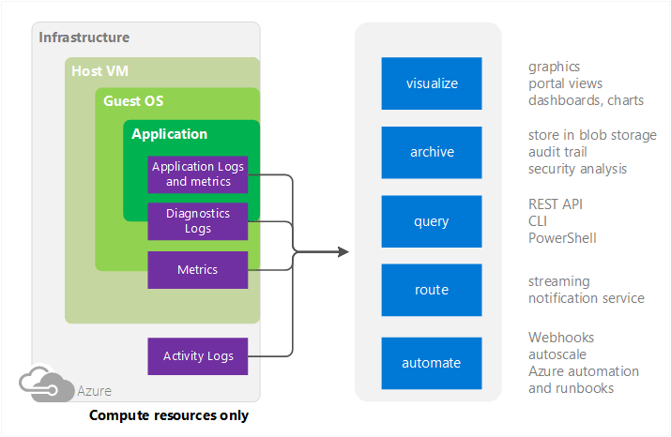
Azure Monitoring sources
Compute
Host VMs
Compute resource
Applications
Notes:
Some compute resources like Cloud Services, Virtual Machines, and Service Fabric have a dedicated Host VM they interact with, and you can collect metrics on the host in addition to the guest
Compute resources such as VMs

Slide 6
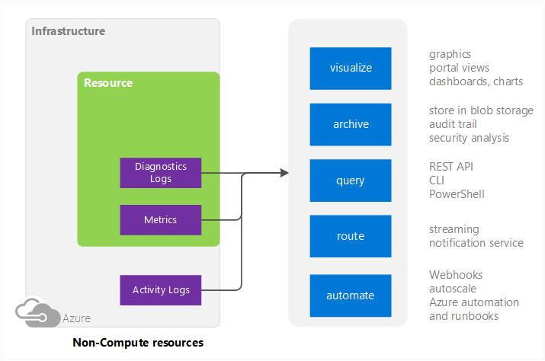
Azure Monitoring sources
Non-compute
Activity Logs (formerly called Audit or Operational Logs)

Slide 7
Azure Monitoring Services
Azure Monitor (previously Azure Insights)
Data from Azure Infrastructure (Activity Log) and each resource (Diagnostic Logs)
Azure Network Watcher
Diagnoses conditions at a network scenario level in, to, and from Azure
Azure Advisor
Best practices to optimize Azure deployments on performance, security, HA, and costs
Azure Security Center
Prevents, detects, and responds to threats on Azure resources.
Log Analytics (part of OMS)
Holistic monitoring of on-premises, Azure, and third party clouds like AWS
Application Insights
Detection and diagnostics at the application layer of services like App Service Web Apps
Notes:
Azure Monitor: Offers visualization, query, routing, alerting, autoscale, and automation on data both from the Azure infrastructure (Activity Log) and each individual Azure resource (Diagnostic Logs)
Log Analytics: Data from Azure Monitor can be routed directly to Log Analytics so you can see metrics and logs for your entire environment in one place

Slide 8
Azure Monitor

Slide 9
What is Azure Monitor?
Built-in monitoring for Azure resources
Out-of-box metrics and logs
Alert rules for notification and actions
Diagnostics’ metrics and activity logs available per resource level or holistically as a “herd” of resources.

Slide 10
Metrics (performance counters)
Collected with one-minute frequency
Retained for 30 days
Out-of-the-box (no setup or storage account required), only available for host metrics.
Azure extension required for Azure VM metrics. Specific logs to collect specified through XML file.
Export to Blob storage, Azure Event Hubs, or OMS.
Configure alert rules on metrics.
Notes:
You can access host-level metrics from VMs (Azure Resource Manager-based) and Virtual Machine scale sets without any additional diagnostic setup. These metrics are not to be confused with the Guest-OS-level metrics that you have access to when you turn on Azure Diagnostics on your VMs or Virtual Machine scale sets

Slide 11
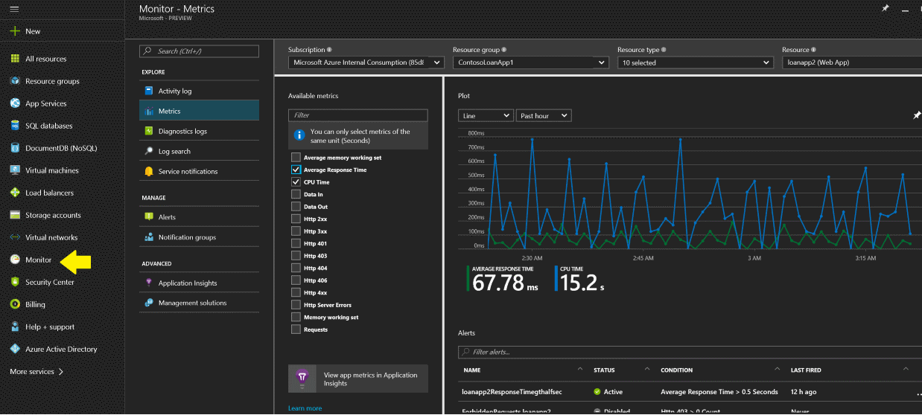
Metrics (performance counters)

Slide 12
Activity Log vs. Diagnostics Logs
Diagnostic Log
Performance Counters
Event logs (System, Application, Security)
IIS logs
Crash dump data
Custom Error Logs
Activity Log
Also called the audit log
Records operational details
Who did what and when in Azure
One-off resource monitoring should be the exception and not the rule. Only use when troubleshooting.
Notes:
"The Activity Log differs from Diagnostic Logs. Activity Logs provide data about the operations on a resource from the outside. Diagnostics Logs are emitted by a resource and provide information about the operation of that resource.
You can retrieve events from your Activity Log using the Azure portal, CLI, PowerShell cmdlets, and Azure Monitor REST API."

Slide 13
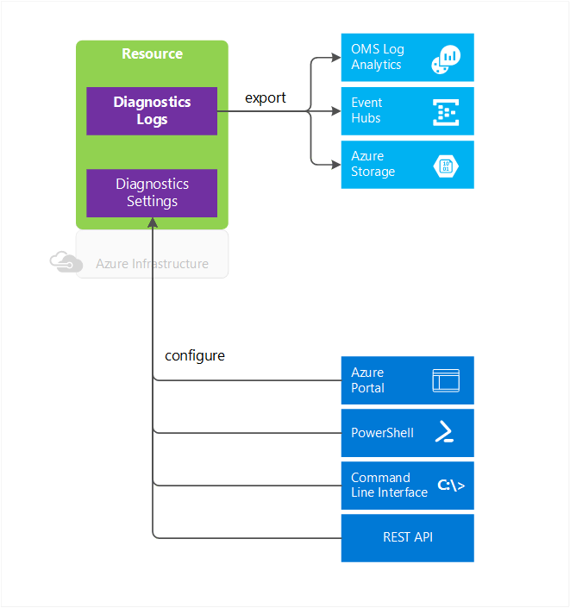
Diagnostic Logs
Diagnostics from a specific resource
Logs contents vary by resource type
Logging needs to be enabled.
Can be stored in Storage account, streamed to Event Hubs, or sent to OMS Log Analytics
365-day retention with storage account
Notes:
Windows event system logs are one category of Diagnostic Log for VMs. Blob, table, and queue logs are categories of Diagnostic Logs for storage accounts
On Windows and Linux Azure VMs, OS-level diagnostics logs are enabled through a Windows or Linux specific VM extension. This extension must be configured using a XML file which will specify the logs to collect.
For OMS Log Analytics to be able to get Azure VMs OS-level metrics, the OMS extension must be enabled for the Windows or Linux Azure VM.
IaaS Diagnostics extension for Windows and Linux vs. OMS extension for Windows and Linux are two separate extensions.
Save diagnostics logs to a Storage Account for auditing or manual inspection. You can specify the retention time (in days) using the Diagnostic Settings.
Stream them to Event Hubs for ingestion by a third-party service or custom analytics solution such as PowerBI.
Analyze them with OMS Log Analytics

Slide 14
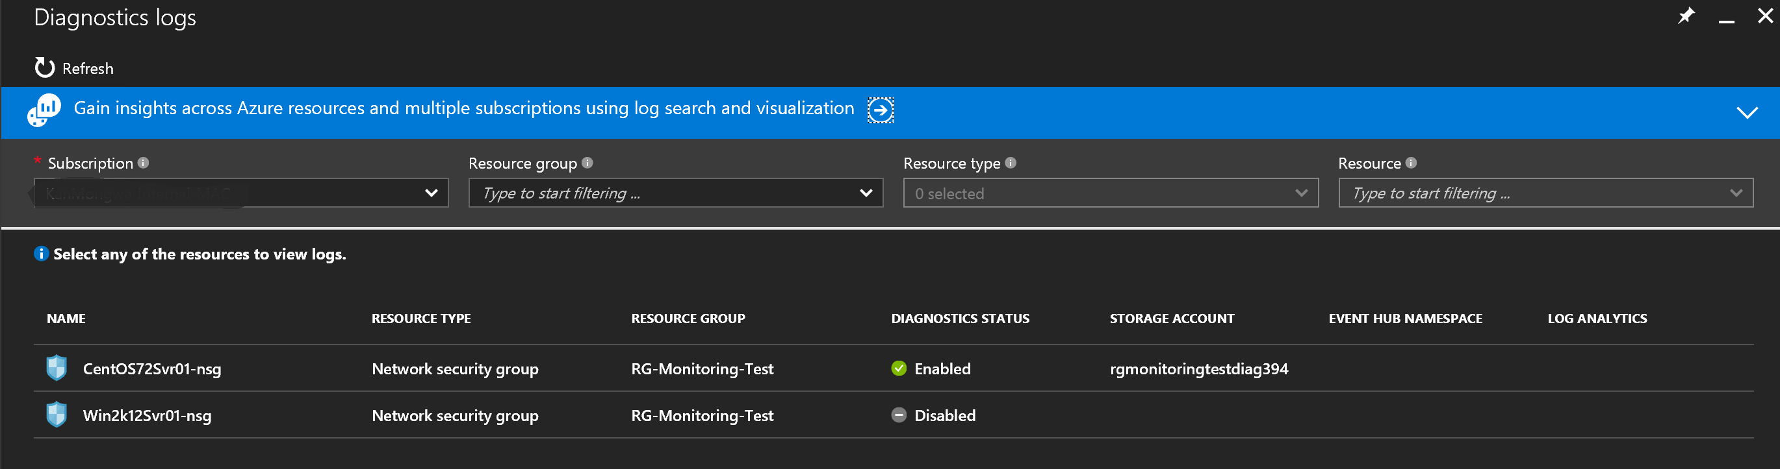
Diagnostic Logs

Slide 15
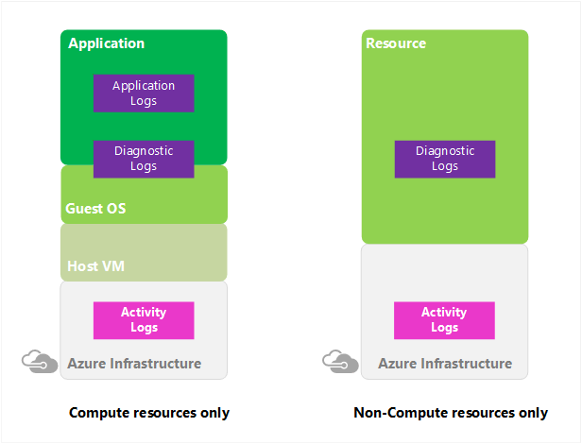
Activity Logs
Formerly called “Audit Logs” or “Operational Logs”
Logs operations performed on resources in subscription. Who is doing what on your resources?
Excellent source for security admins to get audit trails for Azure resources
Retained for 90 days
Export to Blob storage or stream to Event Hub and analyze with Power BI
Create email or webhook triggers off events
Notes:
"The Azure Activity Log is a log that provides insight into the operations that were performed on resources in your subscription. Using the Activity Log, you can determine the ‘what, who, and when’ for any write operations (PUT, POST, DELETE) taken on the resources in your subscription. You can also understand the status of the operation and other relevant properties. The Activity Log does not include read (GET) operations or operations for resources that use the Classic/"RDFE" model."

Slide 16
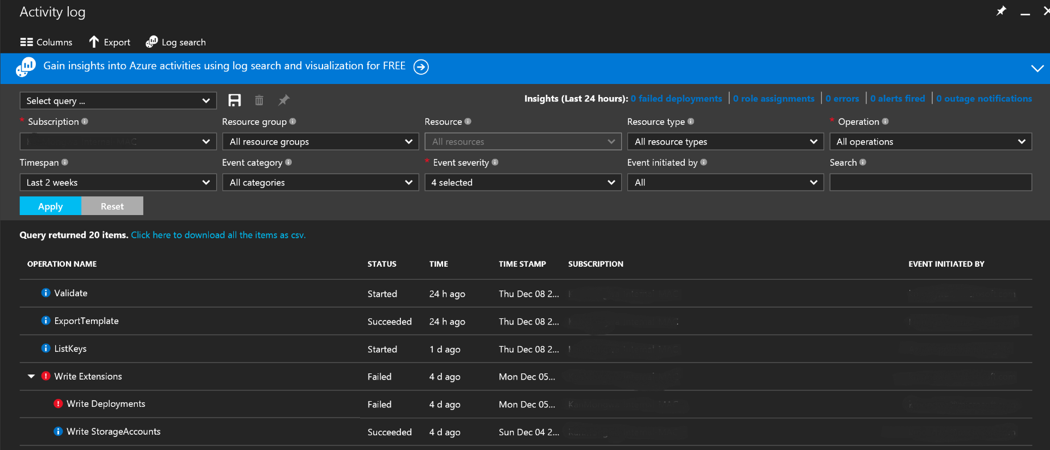
Activity Logs

Slide 17
Metric Alerts
This alert triggers when the value of a specified metric crosses a threshold that you assign in either direction. That is, it triggers both when the condition is first met and then afterward when that condition is no longer being met.
You can configure an alert to do the following actions:
Send email notifications to the service administrator, to co-administrators, or to additional email addresses that you specify.
Call a webhook, which enables you to launch additional automation actions. Examples include calling:
Azure Automation Runbook
Azure Function
Azure Logic App
a third-party service

Slide 18
Activity Log Alerts
This alert can trigger when a particular event occurs on a resource, or when a service notification is posted to your subscription.
You can configure an alert to do the following actions:
Trigger whenever a specific event occurs one of the resources under your subscription
Trigger whenever a service notification is posted to your subscription
Alert members of an action group via
SMS
Email
Webhook

Slide 19
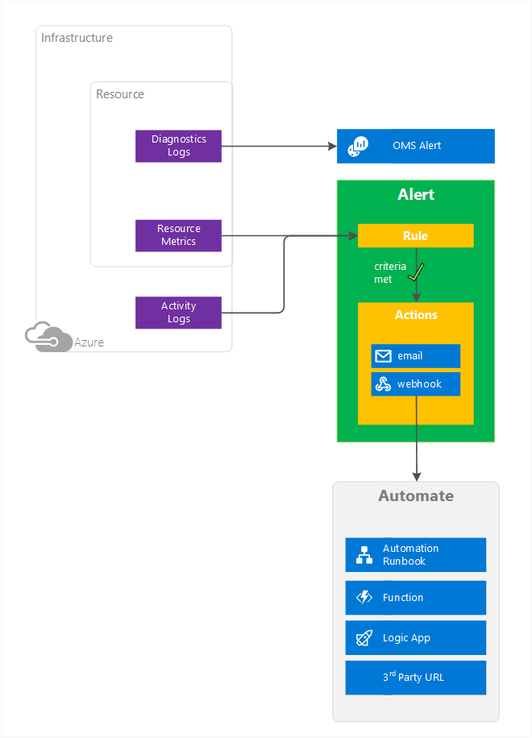
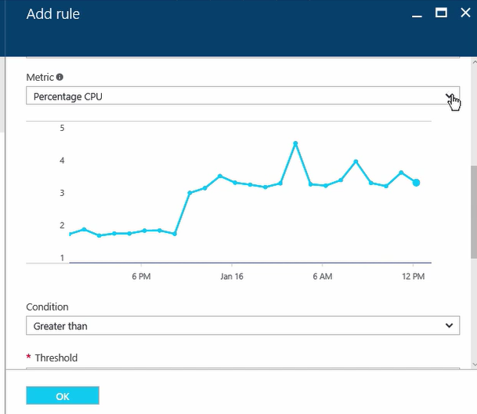
Alerts

Slide 20
Network Watcher

Slide 21
What is Network Watcher?
Regional service that enables monitoring and diagnosing through insights on the following Azure network resources:
Topology: Network level graphical topology on Azure networking resources.
Variable Packet Capture: Captures packet data in/out of a VM. Can be stored in blob storage and locally in .cap format.
IP flow verify: Checks if packet is allowed/denied by NSGs based on 5-tuple packet info.
Next hop: Determines next hop for packets being routed in the Azure Network fabric for UDR troubleshooting.

Slide 22
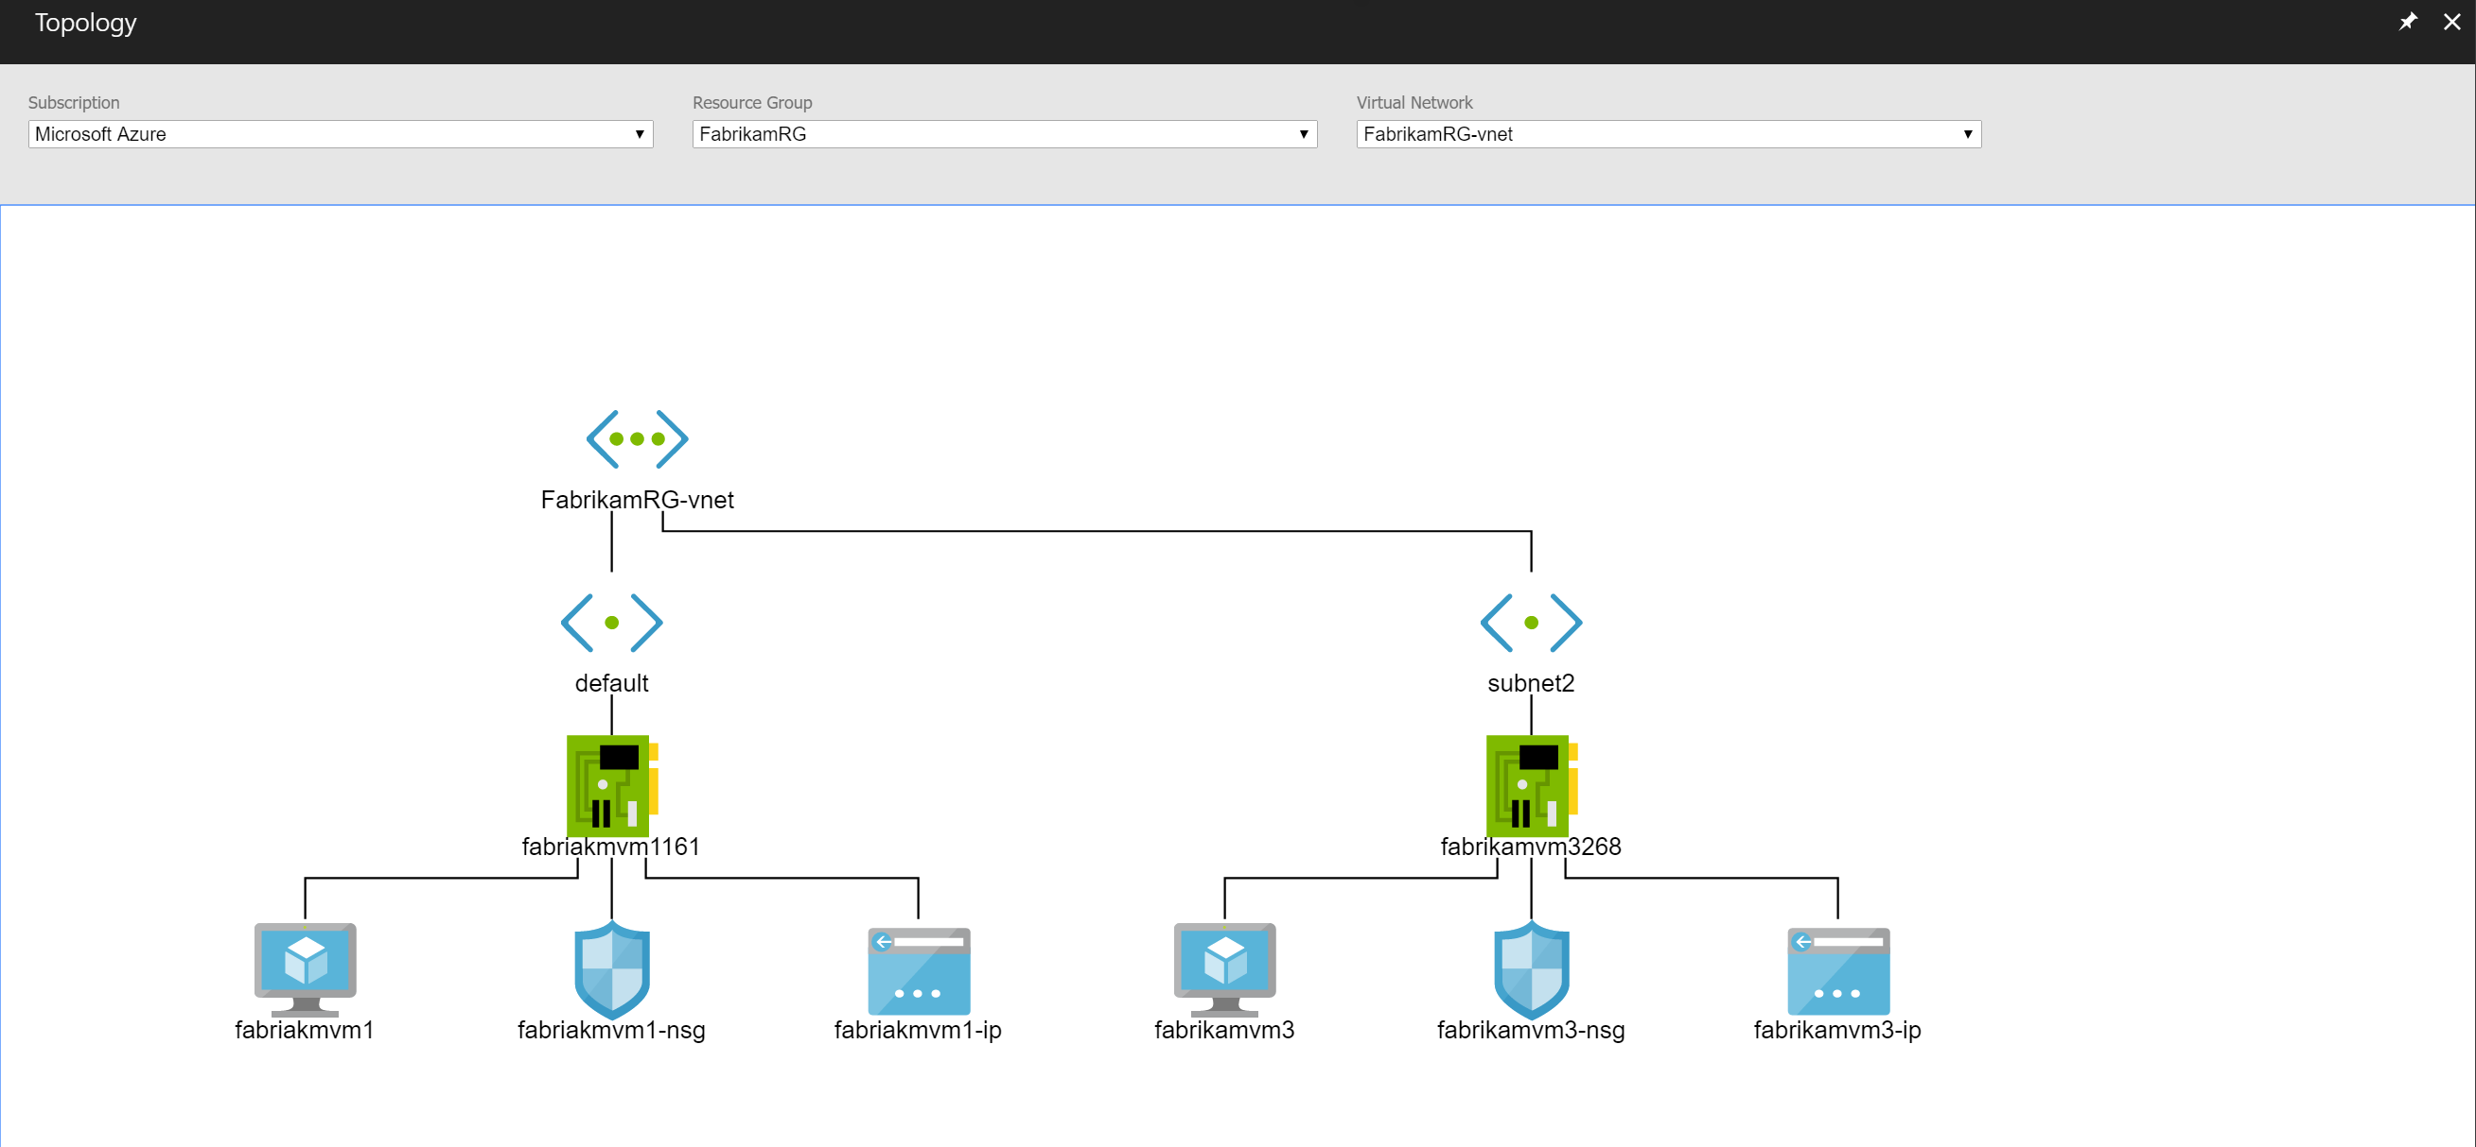
Topology

Slide 23
What is Network Watcher?
Security Group View: Gets effective and applied security rules that are applied on a VM.
NSG Flow Logging: NSGs logs on traffic that is denied/allowed
Virtual Network Gateway and Connection troubleshooting: Troubleshoot Virtual Network Gateways and Connections.
Network subscription limits: View network resource usage against limits.
Configuring Diagnostics Log: Enable/Disable Diagnostics logs for network resources in a resource group

Slide 24
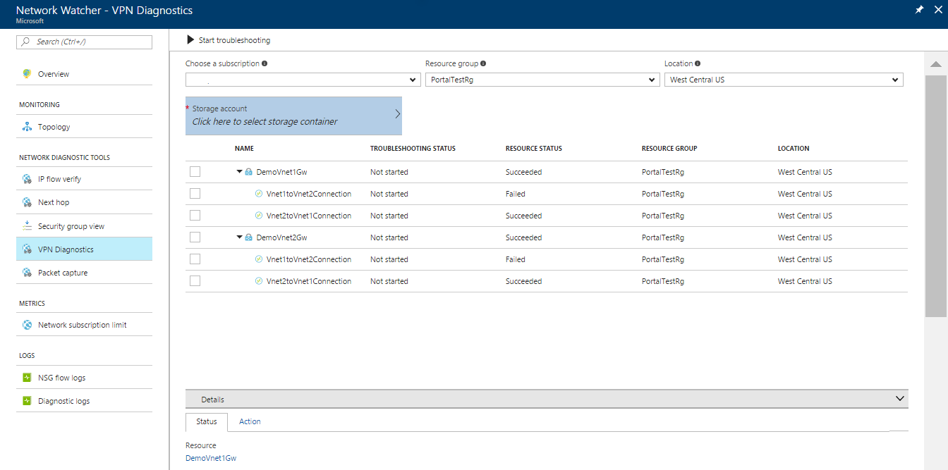
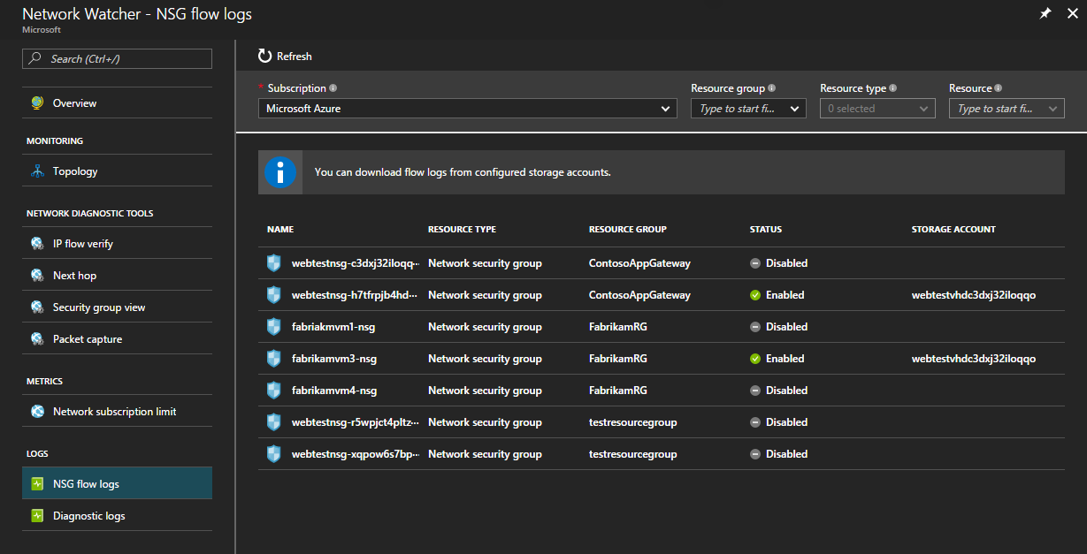
NSGs Flow Logging and VPN Gateway Logs

Slide 25
Azure Advisor

Slide 26
What is Azure Advisor?
Analyzes Azure resource configuration and usage telemetry to provide recommendations on the following:
High Availability: VM Fault tolerance, application gateway fault tolerance, reliability of VM disks, and VM accidental deletion.
Security: Integrates with Azure Security Center to provide recommendations.
Performance: SQL DB databases, Redis Cache, and Azure’s App Service.
Cost: Optimize spending by resizing underutilized instances and implementing cost effective SQL databases.

Slide 27
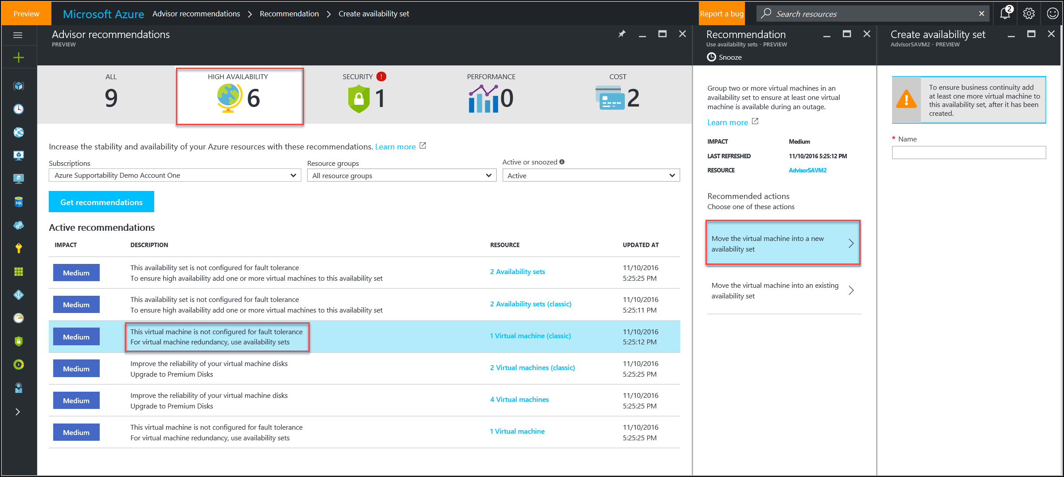
What is Azure Advisor?

Slide 28
Azure Security Center

Slide 29
What is Azure Security Center?
Create Security Policies
Recommendations
Security Alerts
Partner Solutions available for additional features
Integrate with other SIEM systems through Microsoft Azure Log Integration and export data to PowerBI
Can be purchased as part of OMS
Available in different tiers for Basic vs. Advance threat detection
Notes:
Microsoft Azure Log Integration will integrate with other SIEM systems and send Virtual Machine logs, Azure Activity Logs, Azure Security Center Alerts, among other Azure Resource Provider’s Logs.

Slide 30
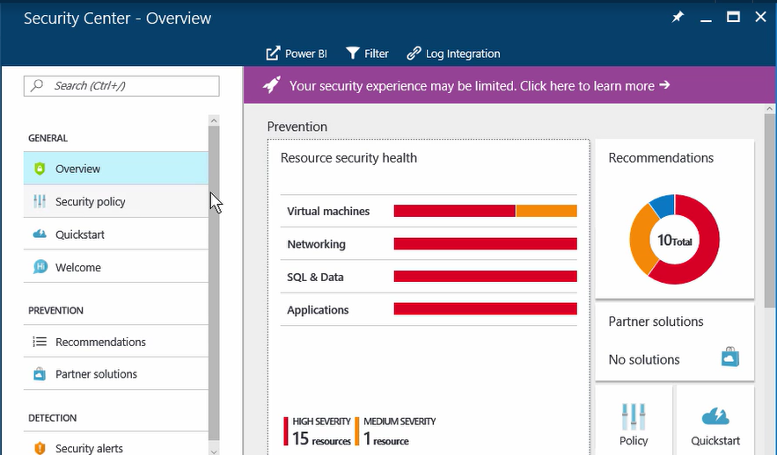
Azure Security Center

Slide 31
Security Policies
Enable or Disable VM data collection and send it to Azure Storage.
Configured based on Prevention Policy categories such as:
System Updates
OS vulnerabilities
Endpoint Protection
Disk Encryption
Network Security Groups
Etc.
Created globally for a subscription, which all resource groups will inherit. Inheritance can be overwritten per resource group.
Email and SMS Text for incident alerts.

Slide 32
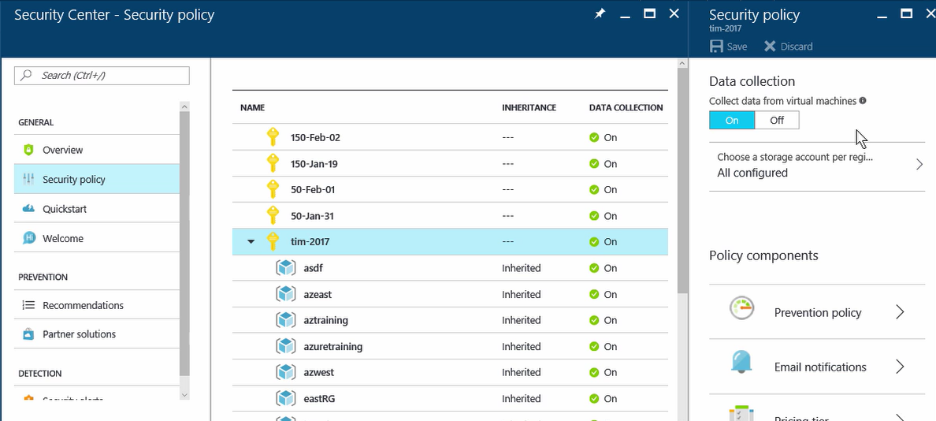
Security Policies

Slide 33
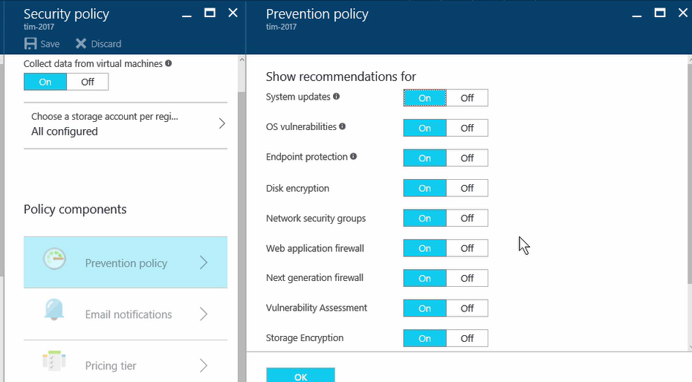
Security Policies: Prevention Policies

Slide 34
Recommendations
What has Security Center observed in the Azure infrastructure and what is the recommendation on these incidents for Prevention purposes.
Based on advanced vs. basic threat analytics tier chosen
Auto-remediation steps available on each recommendation
Recommendations must be periodically scanned

Slide 35
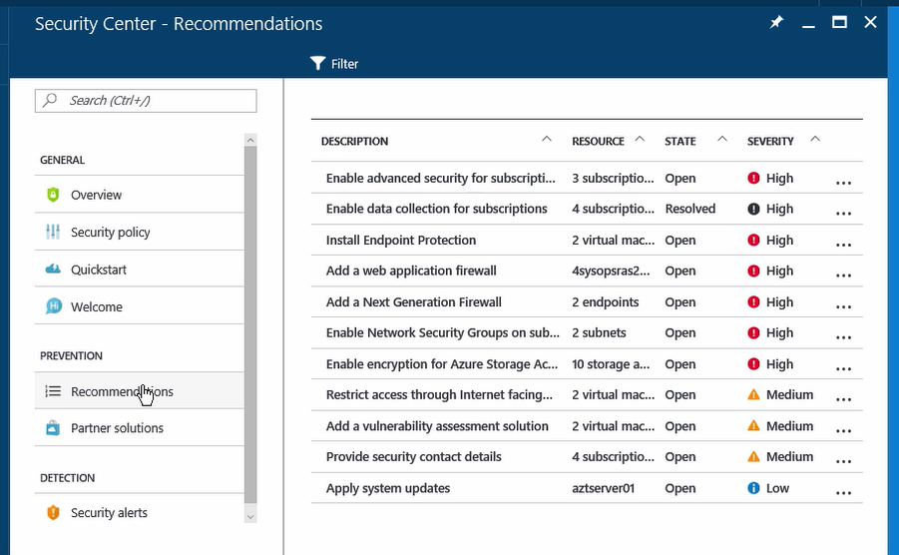
Recommendations

Slide 36
Security Alerts
What has Security Center detected in the Azure infrastructure and what is the alert on these incidents for Remediation purposes.
Provides report and remediation steps
Alerts must be periodically scanned

Slide 37
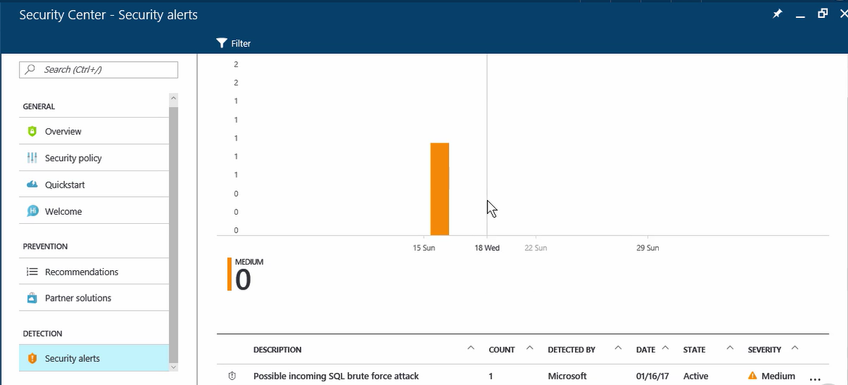
Security Alerts

Slide 38
OMS Overview

Slide 39
OMS Target Solutions
Too Many Data Sources: “Log Flood”
Azure OMS Extension for cross-cloud VM data collection
Analysis of “Log Flood” Data
Log Analytics as single-place intelligence engine to analyze all data sources at once
Response on “Log Flood” Data
Integration with SCOM data sources
Solutions available natively from OMS and 3rd Party
Webhooks and Azure Automation Runbooks available as options to act on alerts based on Log Analytics analysis.

Slide 40
Operations Management Suite (OMS)
Simplified guest and workload management anywhere
HYPER-V
LINUX
LINUX
WINDOWS
HYPER-V
WINDOWS
VMware
LINUX
LINUX
WINDOWS
VMware
WINDOWS
Public Cloud
AZURE or AWS
Private or Hosted Third Party Cloud Rackspace, GCE, etc.
Microsoft
Operations Management Suite
HYPER-V
LINUX
WINDOWS
VMWare
LINUX
WINDOWS
LINUX
WINDOWS
On-premises with System Center
Notes:
Customer environments are spanning on-premises and public clouds
Customer environments are heterogenous running multiple hypervisors and operating systems
Management of services is becoming more complex as service delivery evolves

Slide 41
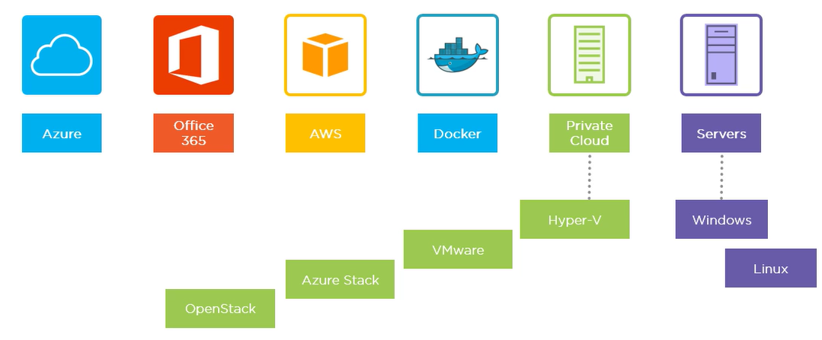
Operations Management Suite (OMS)
Available platforms to integrate as OMS Data Sources:
Notes:
Customer environments are spanning on-premises and public clouds
Customer environments are heterogenous running multiple hypervisors and operating systems
Management of services is becoming more complex as service delivery evolves

Slide 42


OMS Monitoring Targets
Insights and Analytics
Protection and Recovery
Automation and Control
Security and Compliance
Performance and Application specific data from OS and Applications
Integrated with Azure backup and Azure Site Recovery
Hybrid runbook worker
Graphical workbook authoring and automation DSC
Malware assessment
Security posture and system update assessment
Spot problems fast
Protect data easily
Automate tasks quick
Recognize threat early

Slide 43
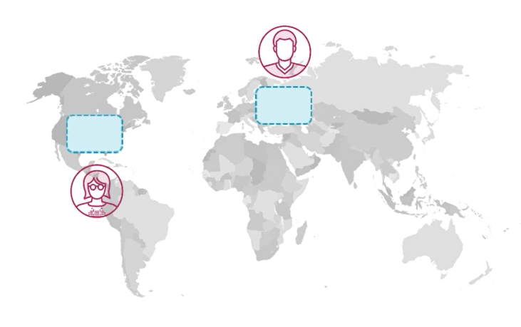
OMS Workspace
Administrative Boundary
All data is collected in the workspace region. Consider this for compliance purposes.
Larger orgs. should consider multiple regional workspaces closest to the infrastructure being monitored.
Workspaces are isolated from one another. They collect data independently.
Link multiple workspaces to single Azure subscription for ease of management.
Delegate workspace responsibility to admins through Azure RBAC.

Slide 44
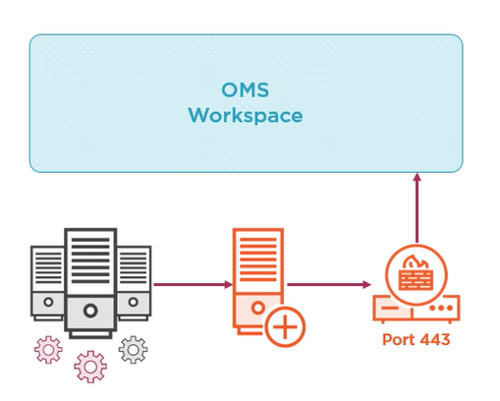
OMS Data Sources
Install the Agent needed for Data Source
Configure data source with OMS workspace
Windows Server 2008 SP1 or above
Internet connectivity through HTTPS for workspace access, use OMS gateway server in DMZ.

Slide 45
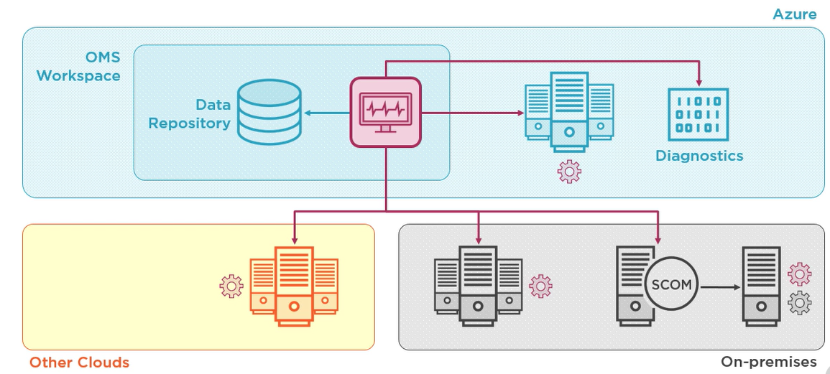
OMS Agent
Notes:
The OMS agent is needed for VMs in Azure and other clouds.
If the VMs are already being managed by the SCOM agent, then the OMS agent might not be necessary. However, this option changes per OMS solution and some solutions might require the OMS agent to be installed in addition to the SCOM agent.
All data is sent to the central data repository which is analyzed by using Log Analytics

Slide 46
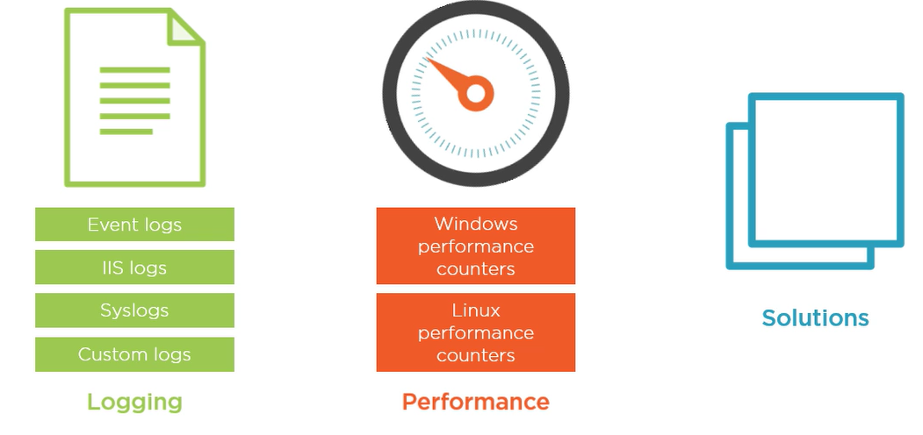
Areas of Data Collection
Connected Data Sources provide data to the following OMS areas:
Notes:
Each area is a section in OMS which can be pinned to the main dashboard.

Slide 47
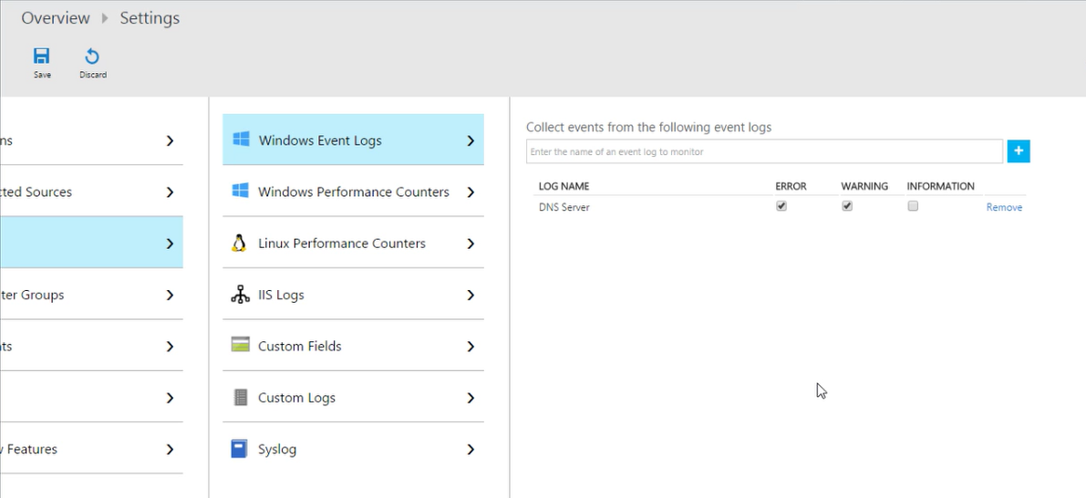
Logs
Notes:
Configurable only after data sources have been connected
Available logs include Windows Event Logs, IIS Logs, Custom Logs, and Syslogs
All logging data is available for analysis from LogAnalytics

Slide 48
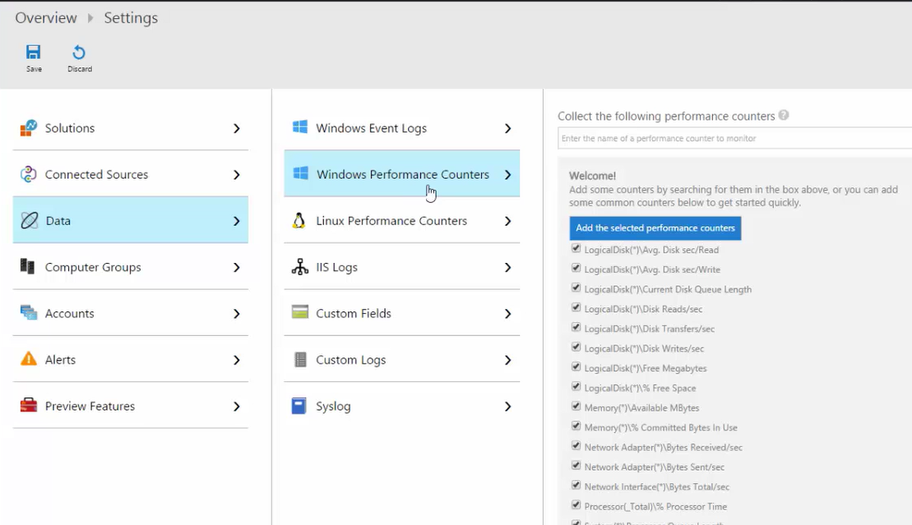
Performance
Notes:
Configurable only after data sources have been connected
Available for Windows and Linux Performance Counters
Performance Counter are available for analysis from LogAnalytics

Slide 49
Solutions
Modules in OMS similar to SCOM Management Packs.
3rd Party Solutions are available.
Solutions come with pre-built Log Analytics queries on connected Data sources to OMS. In addition to dashboards, recommendations, and alerting on the specific system the solution targets.
Solutions are added to the OMS workspace from the solutions gallery as a one-click operation.
Agent requirement changes per solution, some might allow to use the existing SCOM agent, while other solutions might require additional agents other than the OMS or SCOM agent.

Slide 50
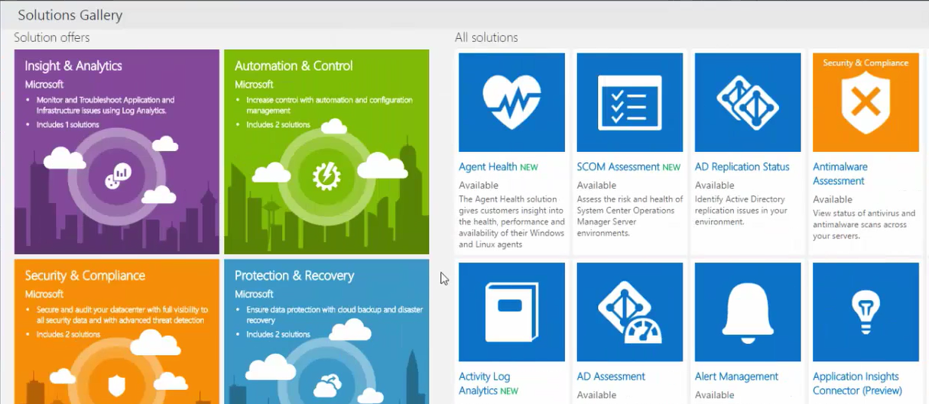
Solutions Gallery
Log Analytics solutions are a collection of logic, visualization and data acquisition rules that provide metrics pivoted around a particular problem area.

Slide 51



SCOM Integration
Collection and monitoring infrastructure
Expanding inventory of knowledge/MPs
Search & Analytics
Microsoft
Operations Management
Suite
Azure Storage
Portal
System Center Operations Manager
Modern design
Amazing performance
Unlimited scale, unlimited retention
SaaS – Near zero management overhead
Windows & Linux Server

Slide 52
SCOM Integration Considerations
OMS and SCOM agent are both the same agent. Both are the same agent process called “Microsoft Monitoring Agent.” No two different MMA agents can co-exist together on the same host.
MMA Agent can multi-home multiple OMS workspaces and SCOM Management Servers connections
90% of OMS solution directly get their data from the VM host of the MMA agent. Only workspace information is sent by the SCOM Management Server. Be sure to open firewalls from both the MMA host (data source) and SCOM Management Server.
There exist two separate product packages for the MMA agent. One for SCOM 2012 R2 and one for SCOM 2016. Only difference is that Windows Update catalog sees each as 2 separate products.
Consider 2 deployment scenarios when integrating SCOM and OMS:
SCOM console is already being used to deploy MMA agents: Push the OMS agent through the SCOM console and register the OMS workspace in OMS settings
3rd party tool (e.g. SCCM/Chef/Puppet/Ansible) is already being used to push the MMA agents: Use this tool to upgrade the MMA agent to the latest version and configure the agent to include OMS workspace information.

Slide 53




How data flows to OMS
On-premises environment
5
Service run by authorized personnel in operations team
All activities are logged and can be audited
1
‘Multiple’ management groups
Management server
4
Certificate-based authentication and SSL
Data compression
Agents
Proxy server
Microsoft
Operations Management Suite
OpsMgr DBs
2
Data being forward to Advisor bypass on-premises databases; adds no load to them
6
Separate Azure file partition for each customer workspace
Uses Azure Secure Authentication Service –to-storage communication
Azure Storage
7
Certificate-based authentication and SSL
Authenticate via Org Account or Microsoft Account
Agents directly connecting to Op Insights
Portal
Agents
3

Slide 54
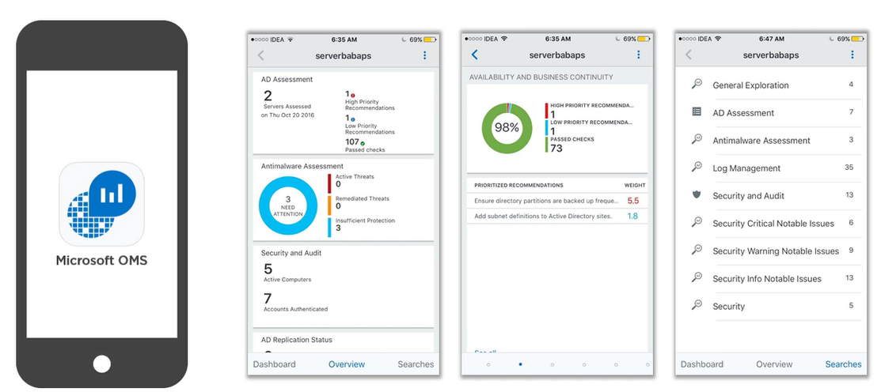
OMS Mobile App
OMS App available in Windows, Android, and iOS. Good for simple queries.

Slide 55
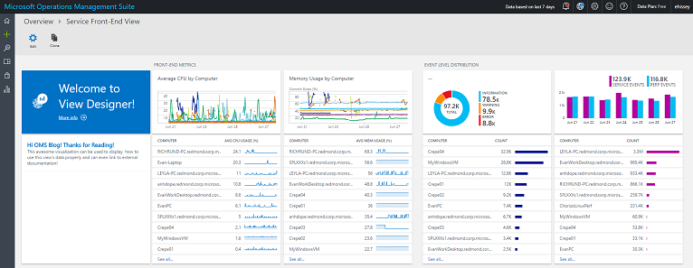
View Designer
Complete with metrics visualized in line charts, distributions of event levels for my service, and the amount of data getting for both types of events. Each visualization can drill down into OMS Log search.
Notes:
Visualize your data your way
https://blogs.technet.microsoft.com/msoms/2016/06/30/oms-view-designer-visualize-your-data-your-way/
Use OMS View Designer for SQL Server monitoring
https://blogs.technet.microsoft.com/msoms/2016/07/22/use-oms-view-designer-for-sql-server-monitoring/
Customize your metrics chart visualization in OMS
https://blogs.technet.microsoft.com/msoms/2016/07/25/customize-your-metrics-chart-visualization-in-oms/

Slide 56
OMS Log Analytics

Slide 57
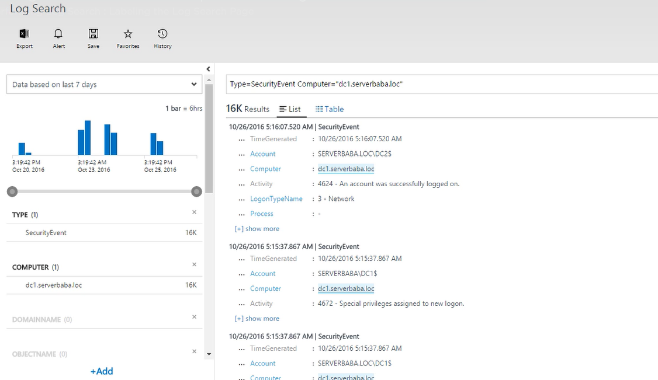
Log Analytics Search Page
Notes:
Log Search Page is the tool for all searches of data sent by connected sources:
Search Box for query
Results: Single vs. Multiple Records
Time Range for Query
Most common filters available
Manual Options, Top Left

Slide 58
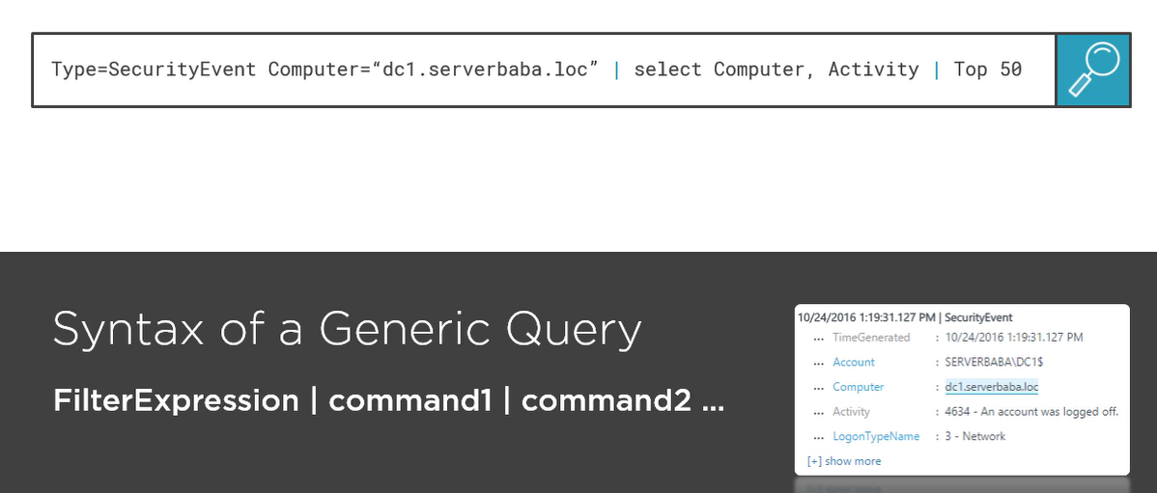
Log Analytics Search Query Language
Notes:
Language Query Syntax is fundamental in order to take full advantage of data analytics offered by OMS

Slide 59
OMS Alerts

Slide 60
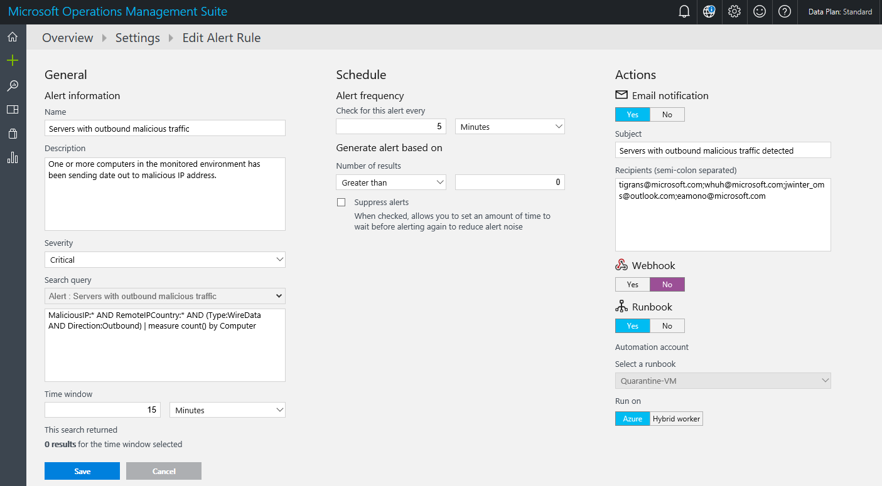
Alerts
Create alerts on queries from Log Analytics
Notes:
Alerts can be created with the following properties:
Severity, search query, time window
5 minutes <= time window <= 24 hours
Thresholds, frequency, suppress
5 minutes <= frequency <= 24 hours
Time Window >= frequency
Email, Runbook, Webhook
Turn off/on as desired

Slide 61
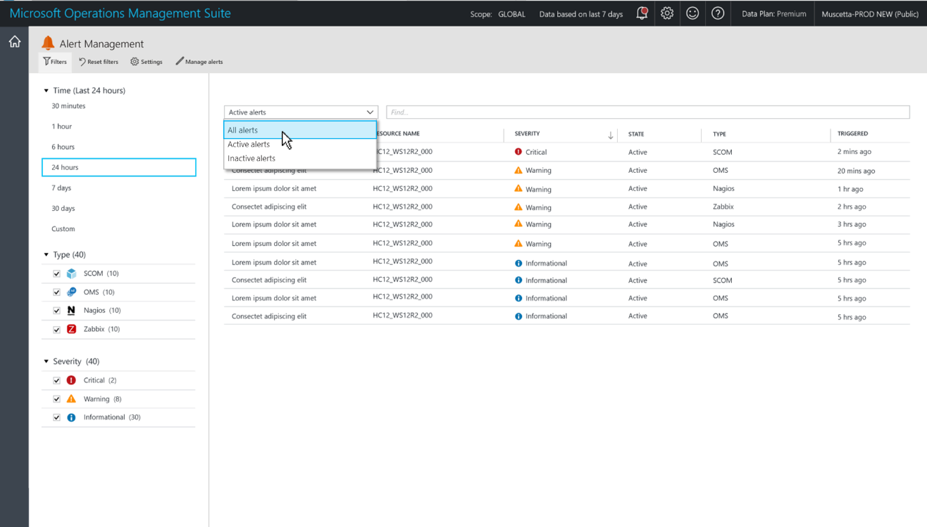
Enable the Alert Management Solution
Solution available in the Solutions gallery for alerts management.
Provides consolidated view of all alerts.
OMS+ SCOM alerts in a single-view pane
Immediately from OMS, 3 minutes for SCOM

Slide 62
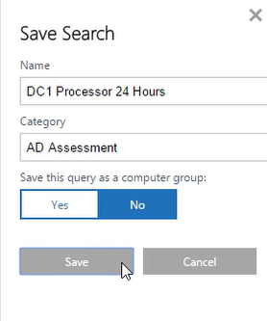
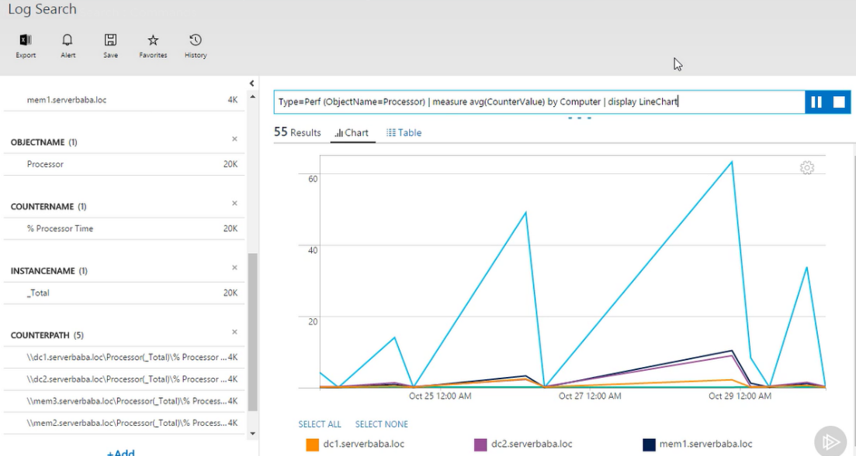
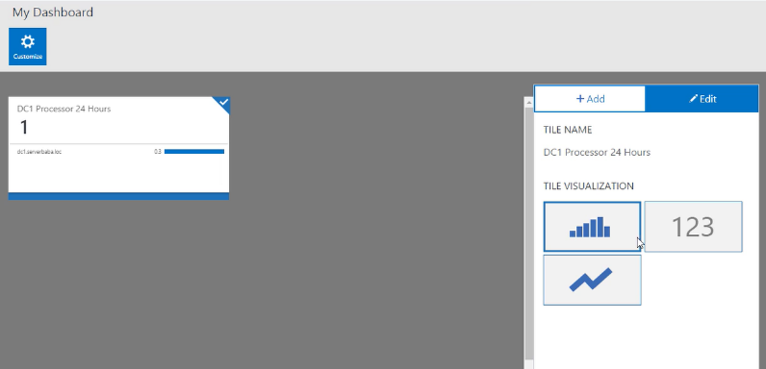
Query Features
Notes:
Queries can be saved, exported, transformed into visual data, and pinned to the OMS workspace dashboard

Slide 63
Application Insights

Slide 64
Application Insights
Application Insights provides actionable insight into web applications, through the following features:
Diagnose exceptions and web app performance issues
Perform root cause analysis with ad-hoc queries and full-text search
Live Application Monitoring
Alert on issues through email and webhooks

Slide 65
Application Insights
HTTP request rates, response times, success rates.
Dependency (HTTP and SQL) call rates, response times, success rates.
Exception traces from server and client.
Diagnostic log traces.
Page view counts, user and session counts, browser load times, exceptions
AJAX call rates, response times and success rates.
Server performance counters.
Custom client and server telemetry.
Segmentation by client location, browser version, OS version, server instance, custom dimensions, etc.
Availability tests.
Azure Functions

Slide 66
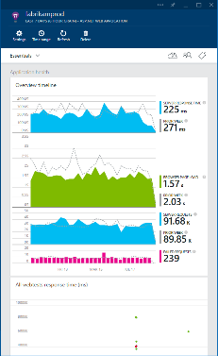
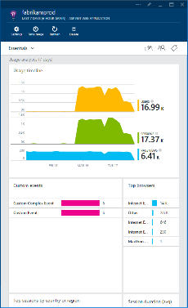
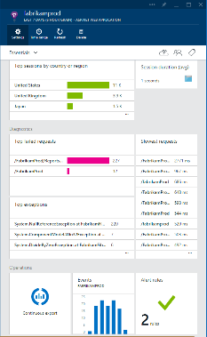



Application Insights
3
Identify, understand, and resolve issues with powerful out-of-the-box and custom telemetry
1
Telemetry is collected at each tier: server back-end, middleware, web service, and browser
2
Telemetry arrives in the cloud where it is stored and processed

Slide 67
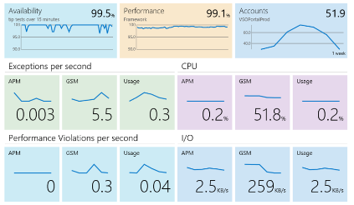
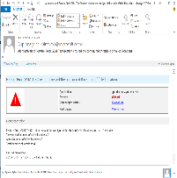
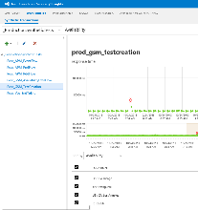
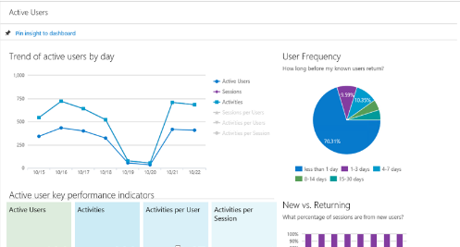
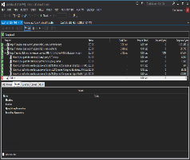
Application Insights
Available
Performing
Succeeding
Health dashboards
Notifications and deep insights
Usage dashboards
Is my application available and performing for users?
One dashboard
What’s wrong?
Show me performance problems, memory usage, and exceptions
Where do we invest next?
Show me top features and customer
Usage patterns

Slide 68
Application Insights supported platforms
Server side:
Net and Java
Agent-based
Windows: Microsoft Monitoring Agent
Azure: Includes Azure Virtual Machines and Cloud Services
ASP.NET
SDK-based
Client side:
Browser (JavaScript)
Windows Phone
Windows Store
Azure websites

Slide 69
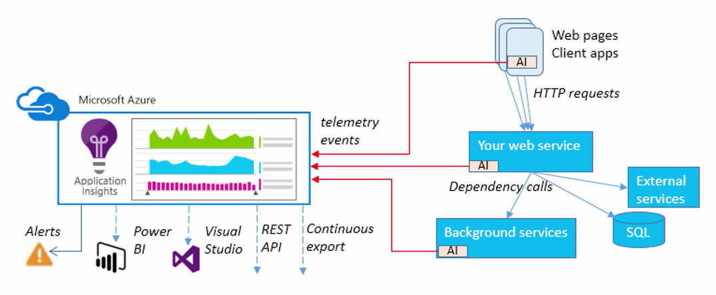
Application Insights

Slide 70
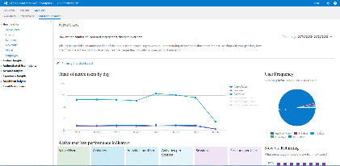
Application Insights
Application
Insights
service
1. Telemetry is collected at each component: usage, performance, exception, crash, event, synthetic transactions, logs, developer-supplied event data
2. Telemetry arrives to Application Insights service where it is processed
3. A 360-degree view of the application – help keep it available, performing,
and succeeding
Notes:
Application Insights for Visual Studio Online lets you monitor your deployed live application.
Find out what users are doing with your app, so that you can focus your development work where it’s most useful.
You can monitor a .NET web service. A .NET service running as an Azure web role, or a Java web service.
Make sure your web service is available and responsive. Whether the app is a web site or a device app that uses a web service, Application Insights can test a URL every few minutes from locations around the world, and let you know if there’s a problem.
Quickly diagnose any performance issues or exceptions in your web service. Find out if CPU or other resources are being stretched, get stack traces from exceptions, and easily search through log traces. And if the app’s performance drops below acceptable limits, we can send you an email. You can monitor both .NET and Java web services.
References:
http://msdn.microsoft.com/en-us/library/dn481095.aspx

Slide 71

Telemetry sources
1
Outside-in monitoring
URL pings and web tests from 16 global points of presence.
2
Observed user behavior
How is the application being used?
3
Developer-emitted traces
App
Whatever the developer would like to send to Application Insights.
4
Observed application behavior
Platform
No coding required – service dependencies, queries, response time, exceptions, logs, etc.
Infrastructure
5
Infrastructure performance
System performance counters.
6
“Meta-telemetry”
Source code, builds, deployments, configuration changes.

Slide 72
SCOM

Slide 73
SCOM for Azure
Use the Azure Management Pack to monitor Azure subscription and resources
For Hybrid Environments, allow SCOM to monitor both on-premises and cloud based resources
Connect with OMS, for enhanced monitoring and analytics of Azure based resources

Slide 74
Hybrid Deployment Options
1. Deploy a SCOM infrastructure in Azure IaaS
Consider SKU VM sizes to optimize SCOM infrastructure in Azure
2. Use your existing on-premises SCOM infrastructure to manage Azure IaaS
Most customers do this today, due to system requirements for management server and supporting SQL database
Consider the following:
How will you connect to Azure, using ExpressRoute or VPN, to connect to on-premises management server.
Deployment of a Gateway Server
Will the Azure IaaS VM s be domain joined?
Domain authentication
Certificate authentication for non-domain joined IaaS VMs
Bandwidth requirements

Slide 75
S2S/ER Implementation Considerations
Deploy agents on IaaS VMs in Azure in same manner that you would with remote site in on-premises deployments.
Can also perform agentless monitoring, but with less functionality

Slide 76
No S2S/ER Implementation Considerations
Must configure a Operations Manager gateway server in Azure
Monitored Azure Servers will need:
Operations Manager Auth Certificate
Gateway Azure Server will need:
Operations Manager Auth certificate
IPSec Certificate

Slide 77
Key decisions

Slide 78
Azure Native E2E monitoring experience
Azure Security Center and Azure Advisor
3rd party products, integrate via REST API, Event Hub, Storage log files
Azure Monitor
(platform monitoring)
Application Monitoring (Application Insights)
Log Analytics, automation, solutions (OMS)
On-prem, hybrid/ external cloud data
Azure services Resource Health
Notes:
Azure Monitor, Log Analytics, other OMS components, and Application Insights can all be viewed in the Azure portal
Monitoring Tiers
First Tier: Azure Services Health and per resource Metrics
Second Tier: Azure Monitor for a holistic view of all Azure resources
Third Tier: Azure Security Center and Azure Advisor
Fourth Tier: OMS Log Analytics for more advanced insights on Azure resources other than the out-of-the-box insights (Azure Monitor).

Slide 79
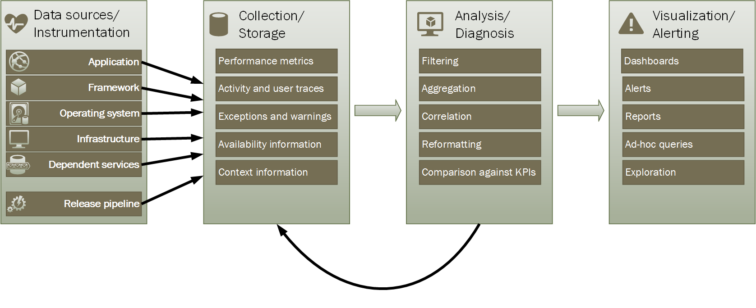
Understand monitoring and diagnostics pipeline

Slide 80
Choose what needs to be monitored
Health Monitor
Availability Monitor
Performance Monitor
Security Monitor
Cost Monitor
Azure Resources: Compute, Storage, Networking Monitoring
Auditing

